Slide 1

作業研究應用與實作 Fianl Project
OPERATIONS RESEARCH APPLICATIONS AND IMPLEMENTATION
Team A : P96124031 林彥丞
P96121041 黃妍綺

Slide 2
Title
Deep-Q-Network(DQN) for job shop scheduling(JSP) problem
This project uses Deep Q-Network(DQN) for job shop scheduling in Reinforcement learning, and the information is taken from the public data platform - http://people.brunel.ac.uk/~mastjjb/jeb/orlib/files/jobshop1.txt.
Notes:
改英

Slide 3
Research Background and Motivation
2.1 Motivation
Why is JSP important?
Production Efficiency and Cost Control
Wide Engineering Application
Complexity Challenge and Research Value
Impact on Supply Chain Management
Sustainability and Resource Utilization
Notes:
1.JSP directly affects the efficiency of production processes. By optimizing job schedules, manufacturers can minimize production time and reduce costs associated with labor and machine usage.
2.Wide Engineering Application
3.Because job shop scheduling has numerous variables and constraints.
4.Delays in one part of the production process can have a knock-on effect, causing disruptions downstream.
5.By optimizing the use of machinery and reducing idle times, energy consumption can be minimized, thereby lessening environmental impact.

Slide 4
Research Background and Motivation
2.2 Background
How to solve scheduling?
Metaheuristic
Neural Netowrk
Reinforcement Learning
Using neural networks to make decisions
Suitable for small-scale problems.
Need to be redesigned when problem structure changes.
Learning algorithms that consider long-term goals
Notes:
In industrial manufacturing, production scheduling holds significant importance.
Today, there are higher demands for such tasks (like job shop scheduling), and scheduling systems need to be capable of handling various variables in production requirements,
such as production demands, processing times, and available machinery. Achieving efficient planning results in a short time for large-scale job shop scheduling is quite challenging.
在工業製造上，生產排程有相當重要的地位，現今針對該任務(如 job shop)有更高的要求，scheduling 系統需要能應對生產需求中的各種變數，如生產要求、加工時間與可用機台等各種變化，在大規模job shop scheduling中在短時間獲得高效率的規劃結果是相當具有挑戰性的。
First, traditional rules of thumb and manual calculations are not considered practical for large-scale production scheduling.
The literature mentions that certain methods, such as Simulated Annealing (SA) and Genetic Algorithms (GA), are more commonly used.
Indeed, these methods can provide excellent solutions, but they need to be redesigned when the problem structure changes.
There is also a significant variance in performance and the different objectives of the problem.
Neural Networks (NN) use neural networks for decision-making, which can address the issues encountered by the former methods. However,
they are limited by the size of the dataset and are more suitable for small-scale problems, making them less than ideal for actual scheduling challenges.
Reinforcement Learning (RL) is a type of learning algorithm that considers long-term goals, taking into account the relationship between states and actions,
and has a learning-based mathematical model. Compared to the previous methods, it can be applied to various scheduling scenarios and respond quickly.
According to the reference papers, achieving a fast, effective, and adaptable scheduling for various situations is also the goal this research intends to realize.
首先不考慮傳統經驗法則與人工計算，在大規模的生產排程下並不實際。
文獻中提到(例如模擬退火法(SA)，基因演算法(GA))是比較常使用的方法，確實該方法可以提供優良的解決方案，但在問題結構發生變化時需要重新設計，
性能差與問題目標的不同也有很大的差異。
而NN則是使用神經網路來進行決策，可以解決前者發生的問題，但受限於資料集數量，較適合使用於小規模問題，在實際的排程問題上並不是那麼理想。
RL是屬於一種考量長期目標的學習演算法，考量狀態與行動之間，且具有學習性的數學模型，相對於前兩者，可以應用於各種情形的排程並快速應對。
參考論文中提出 ，達成高速、有效且能因應各種情形的排程，也是本研究打算實現的目標。

Slide 5
Research Background and Motivation
2.3 Problem Definition
Goal - Use DQN to solve the JSP Problem
each job has a different operating time and execution sequence on different machines, according to its limitations to complete the scheduling work and draw the Gantt chart. And it can be applied to all scheduling data (all 85).
Notes:
Use Reinforcement Learning (RL) to solve the Job Scheduling Problem (JSP), we compare the output results with those obtained by solving the problem through Genetic Algorithms (GA).
This comparison is used to test whether the method is reasonable and advantageous.
透過強化學習(RL)解決JSP，在將輸出結果與透過GA解決問題的結果作比較，用以測試該方法是否合理並占有優勢。

Slide 6
Methodology
3.1 Method Justification
Why choose DQN for scheduling?
This dataset contains a total of 85 Job Shop data of different types, in which files with different beginning names represent different operational structures. To fit different types of effective scheduling design, it is most reasonable to use RL.
Proof
Use Genetic Algorithm (GA) and General Scheduling Method (LPT) to compare with the DQN and prove that this method is better.

Slide 7
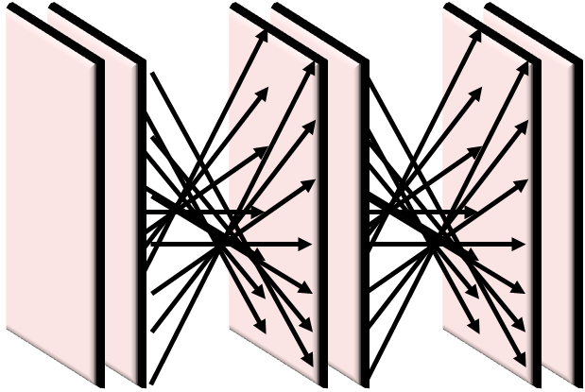
Methodology
3.2 Method
Memory
(Record reward)
PreMemory
Memory
Sum_tree
Send reward
JSP Environment
Dataset
(job, machine, PT, MT)
Choose
Action
Scheduling
State i
State i+1
Agent
(CNN_FNN)
Action space
(all 17)
Notes:
This is our experimental framework, in which the mentioned manufacturing information is inputted, it will then enter into the JSP environment designed by our code.
This environment simulates the production situation of JSP. Subsequently, the data will continuously be trained through the neural network (a combination of CNN and FNN) in the Agent file. Once training is complete, the next action will be selected from the Action space based on the score, and the reward is returned and saved to inform the next action.
It is noteworthy that we have already decided on the PreMemory and Memory methods, which will adjust the priority order of operations based on sample error,
thereby optimizing the reward. Ultimately, we can use this model to complete scheduling of various scales.
以上是我們目前的實驗架構，將剛剛提及的製造訊息輸入後，會進入程式碼設計的JSP環境中，此環境會模型JSP生產的情形。接著資料會持續透過Agent檔案中的神經網路(CNN結合FNN)進行訓練，完成後會依據分數從Action space中選擇下一個行動，並回傳reward儲存起來，替下一次行動提供建議。可以注意到的是，我們目前已經決定PreMemory與Memory方法，會根據樣本誤差調整作業的優先順序，藉此優化reward。最終我們便可以此模型完成各種規模的排程。

Slide 8
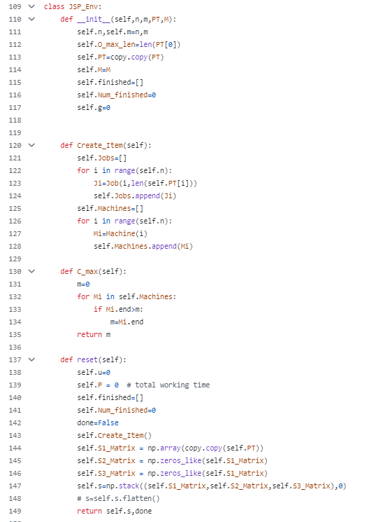
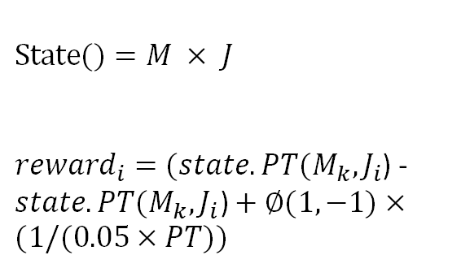
Methodology
JSP_env : Define the structure of a basic job shop
class Machine:
Define the phases and times of operation of the machine.(compute Gap & handling)
class Job:
Define job status and updates.
Class JSP_Env:
Define steps (for Q-table use) and calculate final completion time (Cmax) using the state stages of Machine and Job.
Class Gnatt:
Draw a Gantt chart for each job on each machine operation.
Main : Do LPT scheduling .
$$State()=M × J$$
${reward}_{i}=(state.PT(M_{k},J_{i}$) - $state.PT(M_{k},J_{i}\text{)}+∅(1,−1)×(1/(0.05×PT))$
Notes:
此程式碼用於模擬JSP環境，其中定義狀態空間state的大小為總機器數量乘上工作數，代表每個工作在每個機台的狀態為何。而Reward的設計參考工作間完成的時間差並設計懲罰(獎勵)權重給那些更慢或更慢完成的工作。
This code is used to simulate a JSP environment, where the size of the state space is defined as the total number of machines multiplied by the number of jobs, representing the state of each job on each machine. Reward's design makes reference to the time difference between jobs and design a penalty (reward) weighting for those jobs that finish faster or slower.

Slide 9
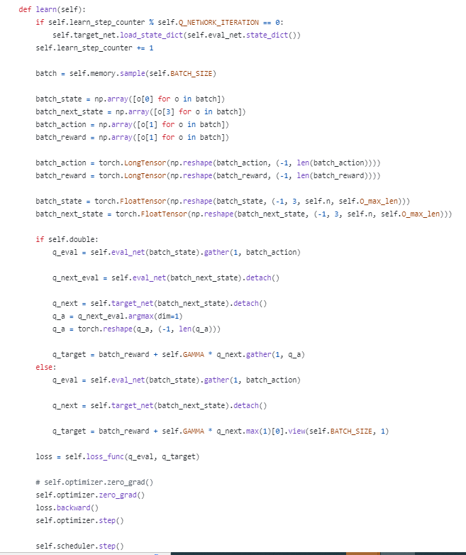
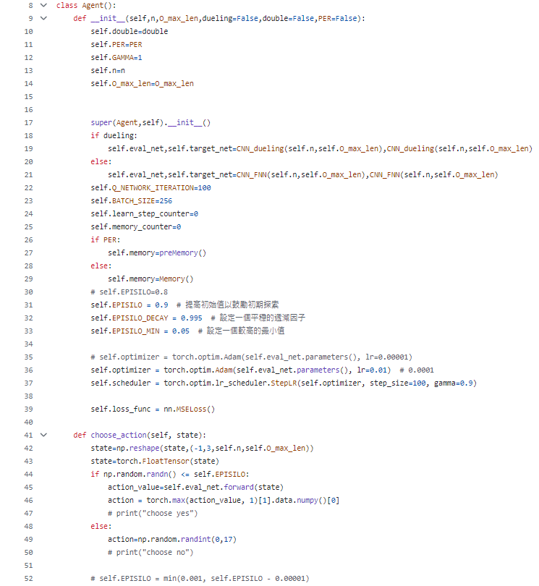
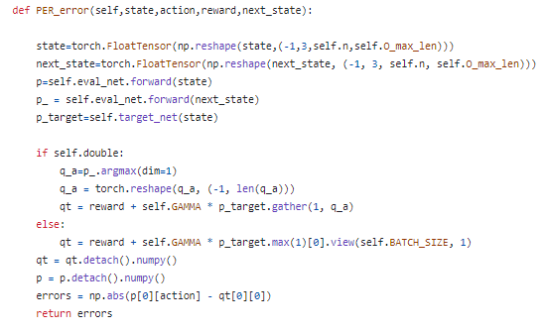
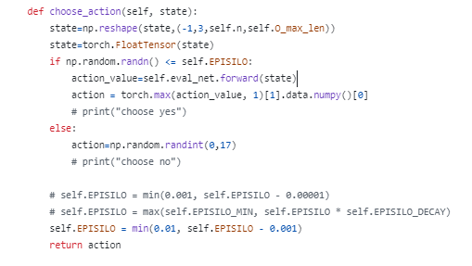
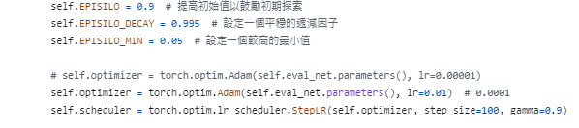
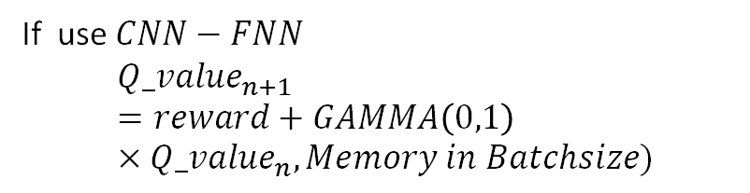
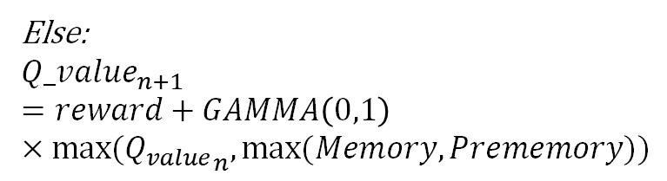
Methodology
Agent: Use exploration rate and learning rate, combined with neural network (CNN_FNN) to select actions.
class Agent:
Setting the learning rate and exploration rate of the optimizer and scheduler.
EPISILO : Rates of Randomized Exploration in Action Space.
Choose action: Selecting Actions Based on exploration rate.
Per_error: Set rewards with or without Experience Replay.
store_transition : Perform Memory Storage
learn: Step-by-step correction of the Q-Table according to batch size and neural network.
$${EPISILO}_{n+1}=min⁡(0.01, {EPISILO}_{n}−0.001)$$
If use $CNN−FNN$
$${Q_value}_{n+1}=reward+GAMMA\left(0,1\right)×{Q_value}_{n},Memory in Batchsize)$$
Else:
$${Q_value}_{n+1}=reward+GAMMA\left(0,1\right)×{max⁡(Q_{value}}_{n},max⁡(Memory,Prememory))$$
Notes:
此程式碼為DQN的控制單位，進行動作的選擇與神經網路訓練。
This code is the control unit of the DQN, which performs action selection and neural network training.
除了神經網路常見的學習率外，探索率代表的是進行全部動作探索並選擇的比率，在神經網路訓練前期需要進行頻繁探索來找出最佳的排程方法，此值會在訓練過程中逐漸下降，代表可以依靠儲存的經驗來進行排程。
In addition to the common learning rate of neural networks, the exploration rate represents the percentage of all actions explored and selected. In the early stage of neural network training, frequent exploration is needed to find the best scheduling method, and this value will gradually decrease during the training process, which means that we can rely on the stored experience to carry out the scheduling.
在DQN環境中，Agent就是依靠此方式來進行Q-table的更新
In DQN environment, Agent relies on this approach for Q-table updates

Slide 10
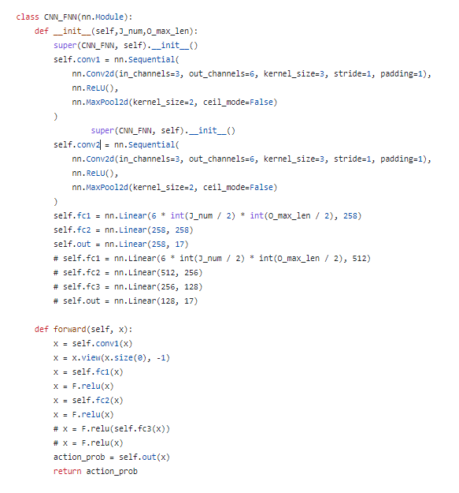
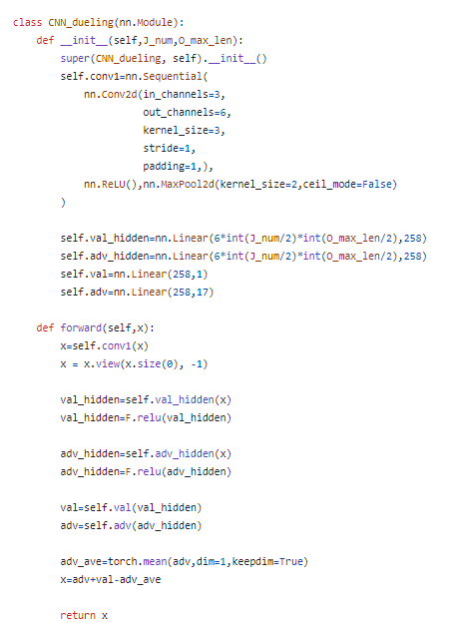

Methodology
RL_network: Realization of Dueling DQN using CNN combined with FNN to provide a training environment for Q-table in Agent
2CNN + 3FNN + Relu
1CNN + 2FNN
Estimated Status Values and Advantages.
$$Loss={\frac{1}{N}\sum_{i=1}^{N}{({Q_value}_{i}}−Q\left(s_{i},a_{i},∂\right)}^{2}$$
Notes:
此程式碼實作了dueling DQN，設計了兩種不同的神經網路架構，一是2層CNN+3層FNN的網路，另一則是1層CNN+2層FNN+隱藏層的網路架構。而在其中還有計算階段值與優勢值的功能，藉由此值可以選擇reward效果更好的神經網路進行排程。
This code implements double DQN and designs two different neural network architectures, one is a 2-layer CNN + 3-layer FNN network and the other is a 1-layer CNN + 2-layer FNN + hidden layer network architecture. There is also a function to calculate the stage value and advantage value, by which the neural network with better reward effect can be selected for scheduling.

Slide 11
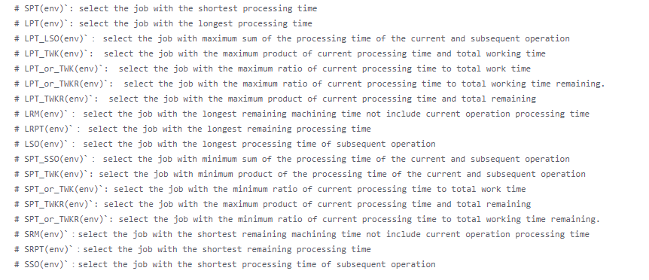
Methodology
Action space:
SPT(env)
LPT(env)
LPT_LSO(env)
LPT_TWK(env)
LPT_or_TWK(env)
LPT _or_TWKR(env)
LPT _TWKR(env)
LRM(env)
LRPT(env)
LSO(env)
SPT_SSO(env)
SPT_TWK(env)
SPT_or_TWK(env)
SPT _TWKR(env)
SPT _or_TWKR(env)
SRM(env)
SRPT(env)
SSO(env)
Notes:
此處有17種不同的動作可以選擇，為參考不同時間段選擇最長或是最短的工作執行。
Total of 17 different actions can be selected, that you can select the longest or shortest job to be performed for different time periods.

Slide 12
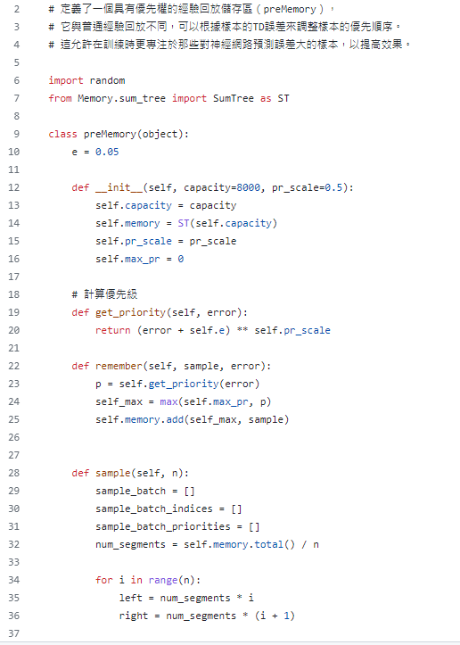
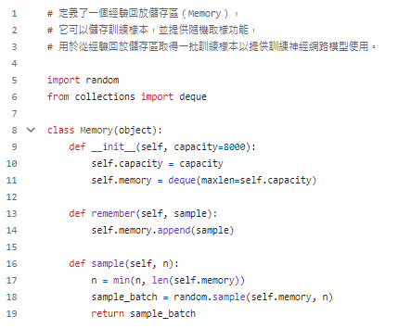
Methodology
Memory/PreMemory: Define different types of memory banks (prioritized or not), Extreme perform are stored in PreMemory or accessed.
Notes:
Two different types of memory storage are defined, among which prememory is suitable for choices with extreme values (either too high or too low rewards), allowing the training to focus on observing choices with neural network errors and improving them.
這邊定義了兩種不同的記憶儲存區，其中 prememory 適用於那些具有極端值的選擇(reward過高或過低)。允許訓練著重觀察神經網路誤差的選擇並改善他們。

Slide 13
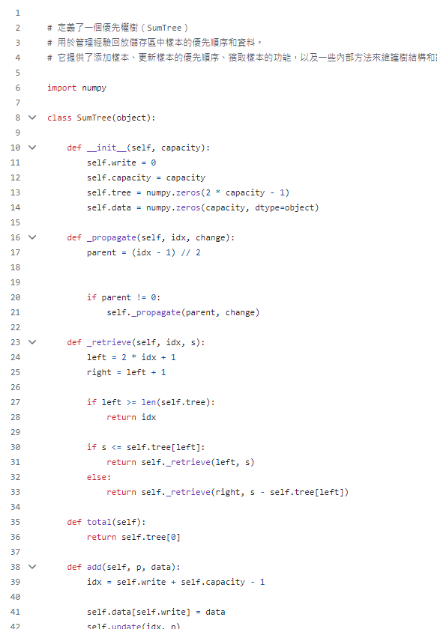
Methodology
Sum_tree: Used to manage the prioritization and data of samples in the experience playback repository.
It provides functions for adding samples, updating sample prioritization, acquiring samples, and some internal methods for maintaining the tree structure and calculating prioritization
Notes:
用於提取、輸入進memory或prememory的控制單位

Slide 14
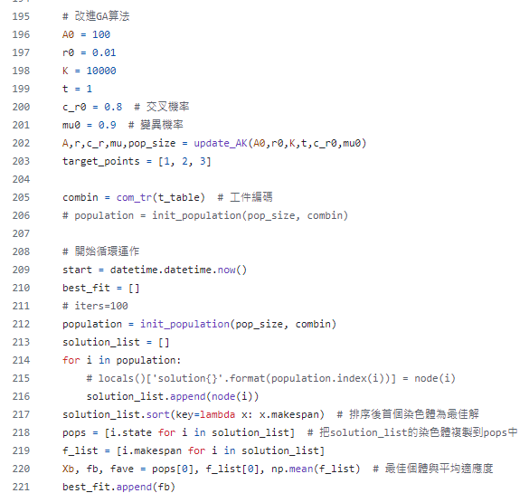
Methodology
Test_case_GA : GA algorithm for comparing scheduling results with DQNs
Initial community size(A0) =100
Selection rate(r0) = 0.01
Crossover probability(C_r0) = 0.8
Mutation rate(mu0) =0.9
Notes:
This is the GA algorithm designed for comparison with DQN, rewritten by referring to a GA algorithm using the same dataset.
The parameters are as shown in the figure, including the initial population, selection rate, mating rate, and mutation rate.
This method schedules through selection, mutation, and evolution from the initial population.
此為設計與DQN作比較的GA演算法，參考使用相同資料集的GA演算法改寫。參數就如此PPT所示，包含初始族群、選擇率、交配率與變異率。此方法從初始族群透過選擇、變異、演化來進行排程。

Slide 15
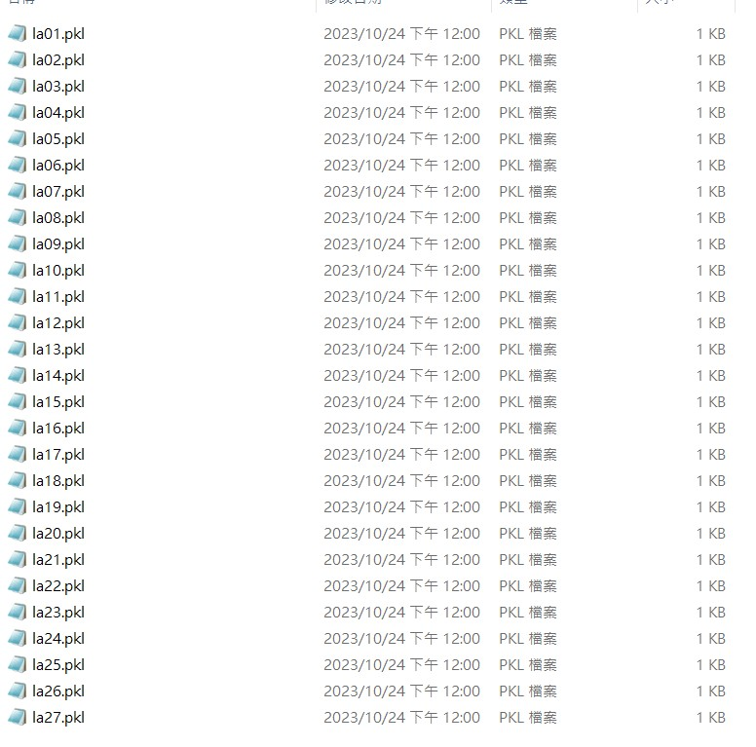
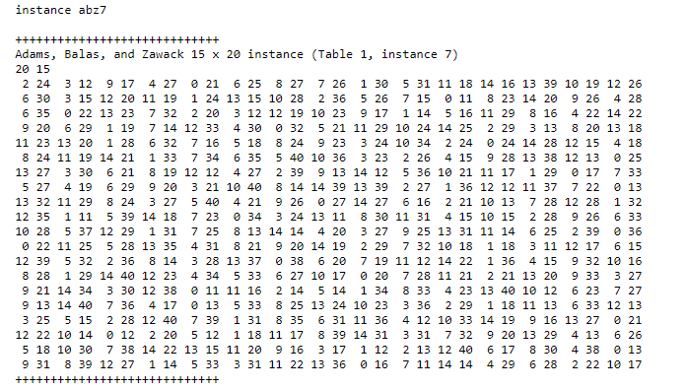
Data Collection and Analysis Result
4.1 Data Collection
Organize all the numerical values of the public data into a .pkl file.
Data_extraction:
All 85 JSP files extracted from the famous OR library. Scheduling times, machine sequences and special restrictions are provided in each data file.
Convert the following data to input form (Job, Machine, PT, MT).
Data Extraction
Notes:
Organize all the numerical values of the public data into pkl file. Each data file contains scheduling times, machine sequences, and special restrictions. Convert the following data into the input format (Job, Machine, Processing Time PT, Machine Time MT).
(將公開數據所有的數值整理，每個數據文件中包含排程時間、機器順序和特殊限制，將以下數據轉換為輸入格式（作業，機器，加工時間PT，機器時間MT）

Slide 16
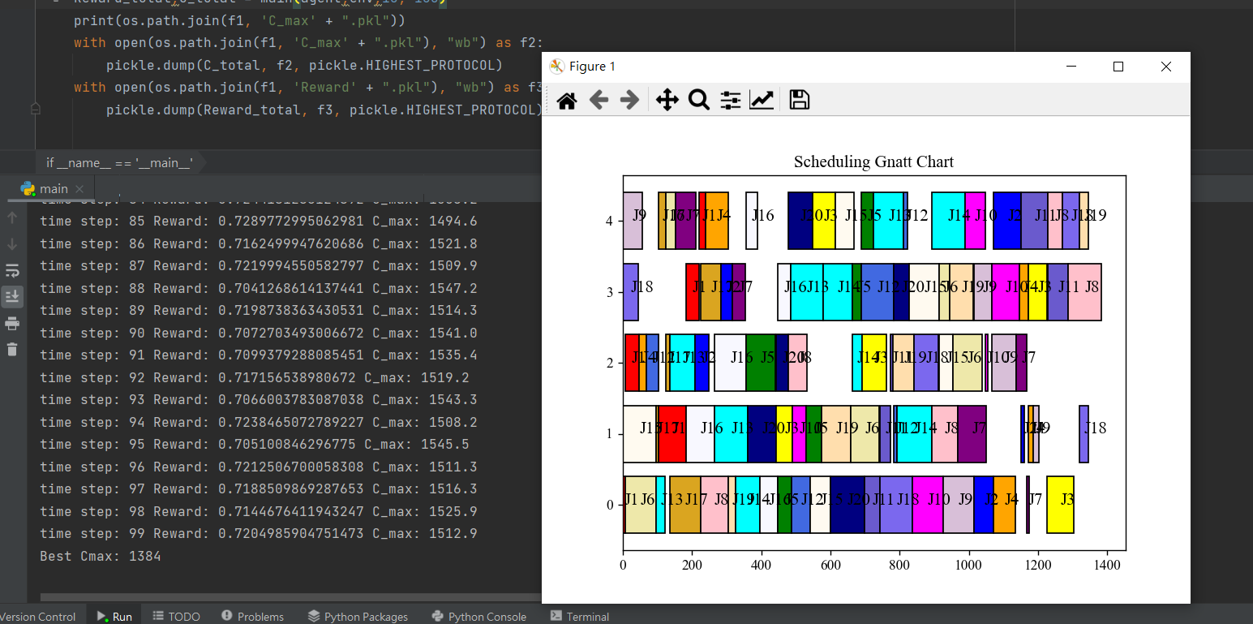
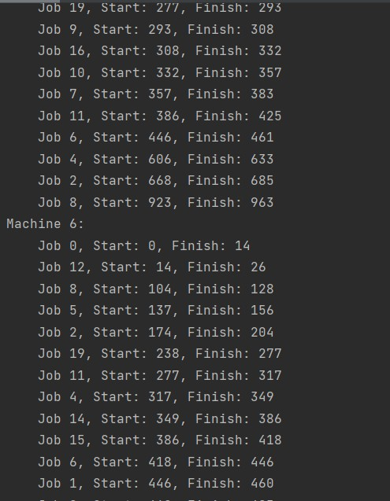
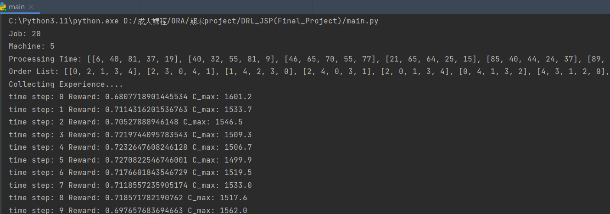
Data Collection and Analysis Result
4.2 Analysis
Notes:
To demonstrate the code implementation, first select the scheduling file you want to work with in the code. After executing the main method, you can observe the format of this scheduling data, displaying the number of jobs, the quantity of machines, work times, and the sequence of machines processed. Subsequently, the DQN will begin training.
This example uses DQN to train on la16 (JSP) with 20 jobs and 5 machines. After running 100 epochs, the best total scheduling time (cmax) can be extracted and a Gantt chart can be drawn.
接下來進行程式碼的實作範例，首先在程式碼中選擇想要排程的檔案，執行main方法後可以觀察此排程資料的形式，此處顯示工作數、機台數量、工作時間與經過機台的順序，接著DQN就會如前面提到的程式碼架構開始訓練，此範例即是使用DQN執行有20個工作、5台機台的la16(排程為jsp)作為範例，執行100次epoch後，便可從中提取最好的總排程時間(cmax)並繪製甘特圖，清楚看出排程結果。

Slide 17
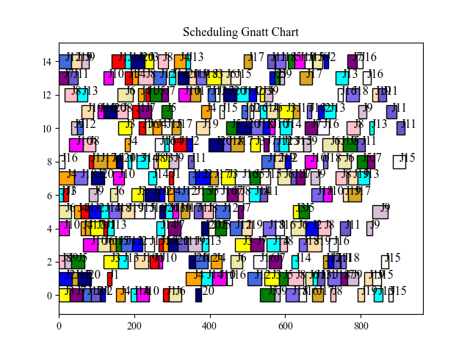
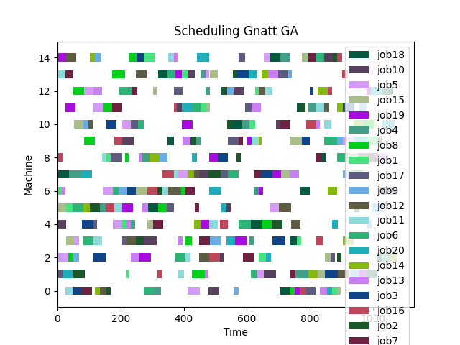
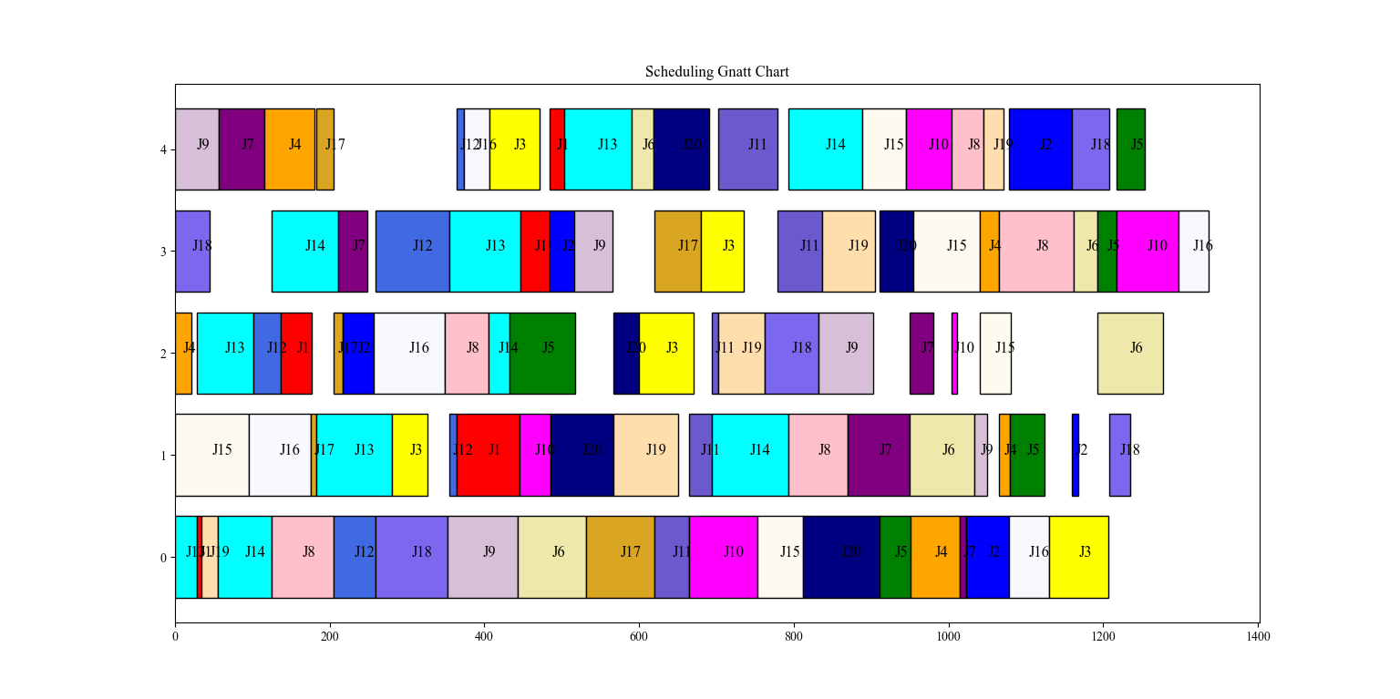
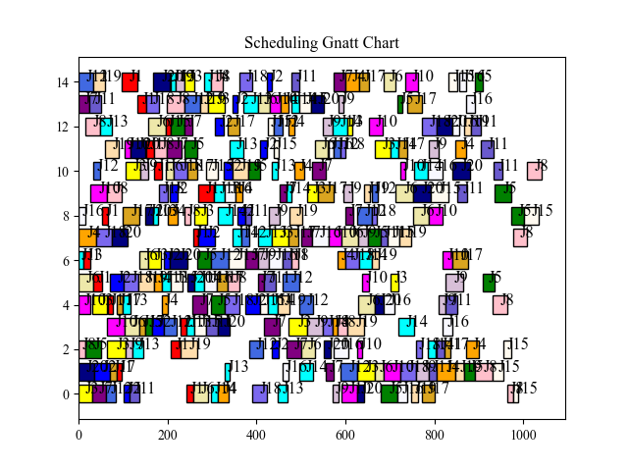
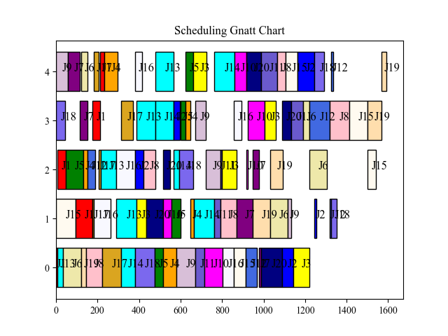
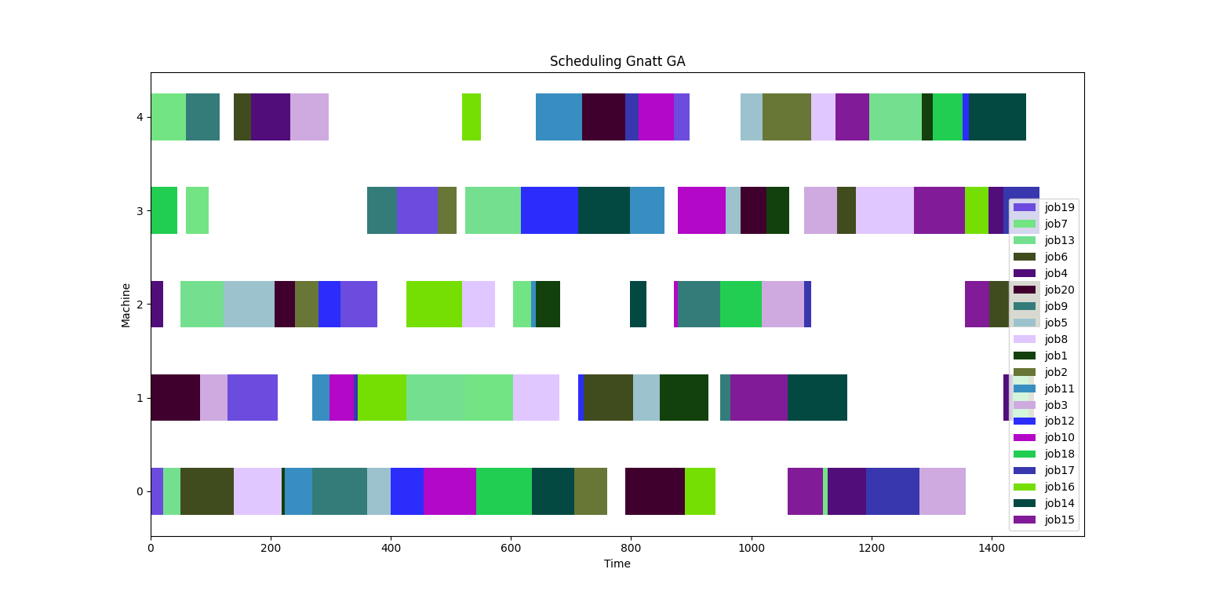
Data Collection and Analysis Result
DQN(epoch=1000) in La16(20,5) scheduling = 1336
DQN(epoch=1000) in abz9(20,15) scheduling = 919
GA in La16(20,5) scheduling = 1481
GA in abz9(20,15) scheduling = 1076
LPT in La16(20,5) scheduling = 1593
LPT in abz9(20,15) scheduling = 1042
Notes:
We used la16 and abz9 as test subjects, where abz9 is a scheduling data with 20 jobs, 15 machines, and has the characteristics of a Flexible Job Shop Scheduling (FJSP).
We compared these two using DQN, GA, and LPT, as shown in the following figures. We found that the results of DQN seem to be superior to the other two,
but we do not have concrete evidence to confirm this, so we conducted several more experiments to verify.
本專案使用剛剛提到的la16與abz9作為試驗對象，abz9是工作數20，機台數15，具有FJSP性質的排程資料。我們將此二者使用DQN、GA與LPT做比較，如下這些圖所示
(依序點完圖片)
我們可以發現DQN的結果似乎優於另外兩者，但我們沒有確切證據說明，故我們多做幾次進行實驗。

Slide 18
Data Collection and Analysis Result
4.3 Results and Managerial Implications
LA16(20,5) | 1 | 2 | 3 | 4 | 5 | 6 | 7 | 8 | 9 | 10 | Mean | SD | Process time
DQN(epoch=20) | 1454 | 1386 | 1425 | 1429 | 1392 | 1416 | 1453 | 1374 | 1426 | 1456 | 1421.1 | 27.8261 | 20s
DQN(epoch=100) | 1397 | 1395 | 1357 | 1400 | 1373 | 1417 | 1345 | 1377 | 1388 | 1396 | 1384.5 | 20.5244 | 100s
DQN(epoch=1000) | 1377 | 1344 | 1324 | 1340 | 1336 | 1402 | 1334 | 1362 | 1335 | 1368 | 1352.2 | 23.1119 | 1000s
GA(840) | 1413 | 1456 | 1456 | 1495 | 1481 | 1492 | 1495 | 1503 | 1456 | 1485 | 1473.2 | 26.2747 | 18.6s
Traditional Scheduling(LPT) | 1543 | 1469 | 1548 | 1593 | 1637 | 1610 | 1595 | 1516 | 1551 | 1473 | 1553.5 | 53.4981 | 1s
abz9(20,15) | 1 | 2 | 3 | 4 | 5 | 6 | 7 | Mean | SD | Process time
DQN(epoch=20) | 953 | 961 | 1038 | 1019 | 1007 | 983 | 993 | 993.429 | 30.6042 | 62.5s
DQN(epoch=100) | 906 | 993 | 961 | 982 | 964 | 928 | 993 | 961 | 33.1964 | 338.2s
DQN(epoch=1000) | 967 | 942 | 931 | 903 | 942 | 919 | 967 | 938.714 | 23.613 | 1383.6s
GA(840) | 1076 | 1084 | 1100 | 1012 | 1079 | 1023 | 1099 | 1067.57 | 35.5568 | 204.3s
Traditional Scheduling(LPT) | 1024 | 1033 | 1040 | 1132 | 1067 | 1042 | 1035 | 1053.29 | 37.174 | 2s
It can be found that the scheduling results of DQN are better than those of GA and general method in different scheduling data of LA16 and abz9.
Notes:
This table shows the results of multiple trials using DQN, GA, and LPT. After several experiments, we can see that DQN already yields better results than GA and LPT in the early stages of training, achieving the shortest total scheduling time and performing well in terms of standard deviation. With the best performance in both types of scheduling data, it is evident that the DQN scheduling designed in this study is effective.
此表格為我們多次進行DQN、GA與LPT的結果，經過多次實驗進行排程，我們都可以看出DQN甚至在訓練初期，就已經有比GA與LPT更好的結果。有最短的總排程時間外在標準差方面也有更低的表現，從兩種不同的排程資料都有最好的表現可以看出本專案設計的DQN排程具有一定程度效果。

Slide 19
Conclusion
In conclusion, this project uses the DQN model to successfully perform scheduling tasks and draw Gantt charts, and also demonstrates the usefulness of the DQN by comparing it with the general method and GA.
Future work:
Reward
Agent
RL
network
Notes:
In my personal opinion, this DQN is still unfinished. There are many potential improvements to be made in the design of the reward function, the Agent, and the neural network.
Regarding the reward, perhaps some feasible statistical methods could be considered for handling. Finally, changes in the algorithms and architecture of the Agent and RL_network might be needed to improve the convergence curve and results.
以我的個人見解上，此DQN還是尚未完成的。在reward function、Agent以及神經網路的設計上，還存在許多可以改良的空間。在reward上或許參考一些統計方法處理是可行的方式而在Agent與RL_network上，可能需要演算法與架構上的改變，便能改善收斂曲線與結果。
In my personal opinion, this DQN is not yet complete. There is still a lot of room for improvement in the design of the reward function, agent and neural network. In the reward function, it may be feasible to refer to some statistical methods, while in the Agent and RL_network, it may require algorithmic and architectural changes to improve the convergence curves and results.

Slide 20
Reference
Luo, S., Zhang, L. X., & Fan, Y. S. (2021). Dynamic multi-objective scheduling for flexible job shop by deep reinforcement learning. Computers & Industrial Engineering, 159, Article 107489. https://doi.org/10.1016/j.cie.2021.107489
Yang, H. B., Li, W. C., & Wang, B. (2021). Joint optimization of preventive maintenance and production scheduling for multi-state production systems based on reinforcement learning. Reliability Engineering & System Safety, 214, Article 107713. https://doi.org/10.1016/j.ress.2021.107713

